Slide 1
Design Project III (EDP3011/2) for Industrial and Communications students
EDP3 Evaluations
Project Categories
Development Tools/Equipment
Construction of the Project
Project Evidence
Selecting a Project

Slide 2
EDP3 Evaluations
The following evaluations will used this semester:
Engineering Business Application Test (40% sub min.)
Draft Proposal: a 2 page document explaining the idea of your project which also includes other requirements (No mark, but need the acceptance from the mentor to continue with the subject.)
Theoretical Design: a document which contains a schematic design of your project, calculations, and results of a simulation of the circuit in MultiSim (if applicable) (50% sub min.)
Proposal: a formal proposal of your project (50% sub min.)
Project Demonstration: a final presentation of the functionality of your project (50% sub min.)
Project Documentation: a final document to present your final findings, test results, construction detail, etc. of your project (50% sub min.)

Slide 3
Project Categories
Pure electronic or communication, no microcontroller
Required level of work:
Design from first principles
Add to existing designs with proof of calculations and design theory
Change existing designs, also with proof
PC-based control with Data Acquisition (DAQ) and Control device
Required level of work:
High-level Graphical User Interface (GUI) design
Control software
Interfacing circuitry
Control system must have inputs AND outputs

Slide 4
Project Categories cont.
Microcontroller with interfacing circuitry
Required level of work:
Control software/firmware
Use existing interfacing circuitry designs, but prove that circuit will work for your project
AND/OR Design interfacing circuitry from first principles
Control system must have inputs AND outputs
Microcontroller with interfacing circuitry and communication with PC/other microcontroller
Required level of work:
Same as above
Implement some kind of a communications protocol to communicate between the devices.

Slide 5
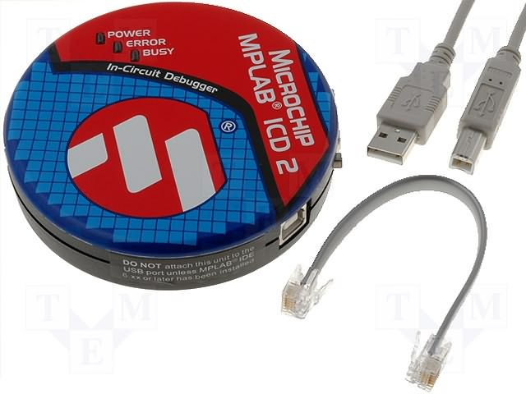
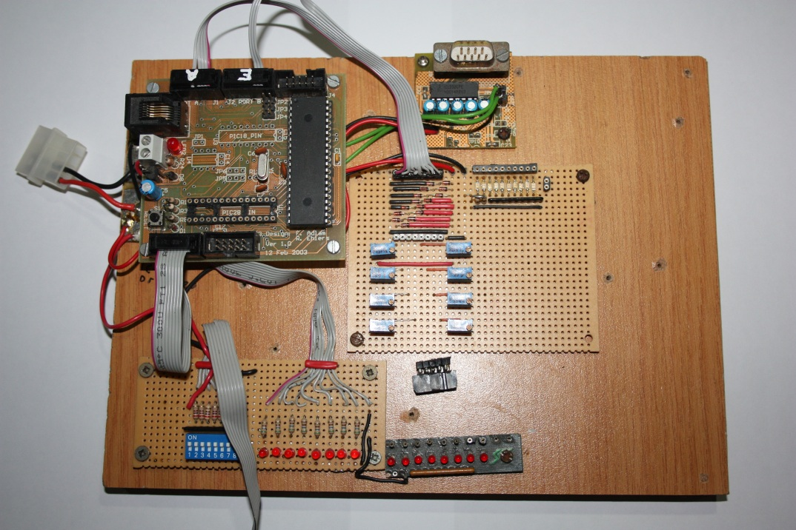
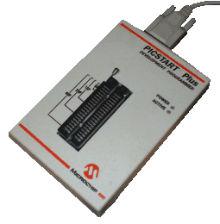
Development Tools/Equipment
MultiPIC Development Board
Development platform for PIC microcontrollers (16F or 18F devices)
Code written in Microchip MPLAB using C18 compiler (available in B102)
Use ICD2 to program the PIC in-circuit
OR use a PICStart PLUS programmer to program the PIC out of circuit

Slide 6
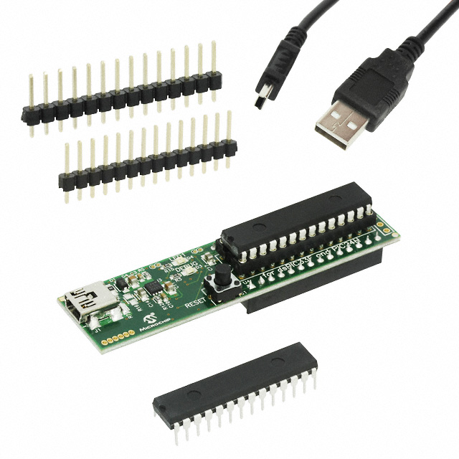
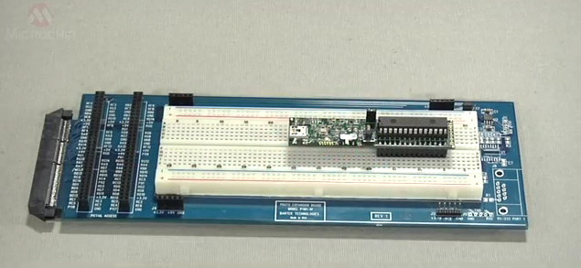
Development Tools/Equipment cont.
Microchip Microstick
Easy to use, economical development environment for dsPIC33F and PIC24H devices
Can be used stand-alone or plugged straight into a “breadboard”
Has an integrated programmer/debugger
Control software is written in Microchip MPLAB using the C24 (or similar) compiler

Slide 7
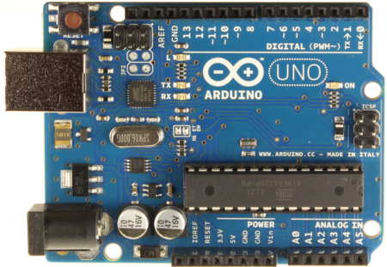
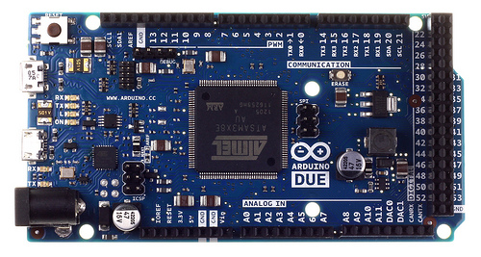
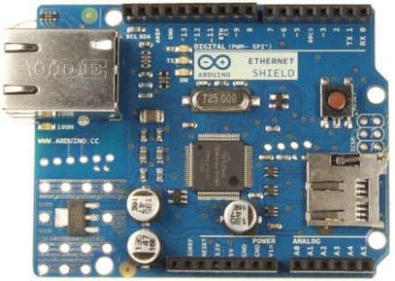
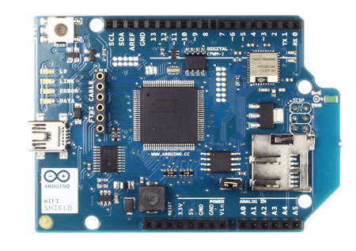
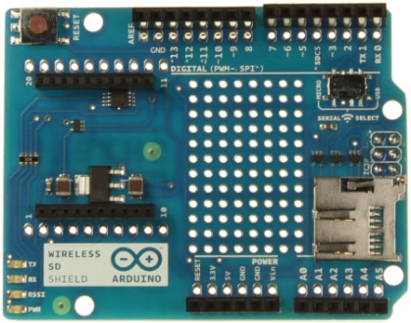
Development Tools/Equipment cont.
Arduino
An open-source development board based on Atmega microcontrollers
Has an integrated programmer
Control software is written in Arduino open-source development software (based on C and C++)
Various models and shields available

Slide 8
Development Tools/Equipment cont.
STM32 Discovery Boards
An easy way to evaluate STMicroelectronics ARM based processors
Has an integrated ST-LINK programmer and debugger
Control software can be developed in various Development environments (Keil uVision4, CoIDE, True Studio, etc.) or open source command line tools
The processors are optimized for C programming and makes use of the standard CMSIS libraries which are available for free.
Different models available:

Slide 9
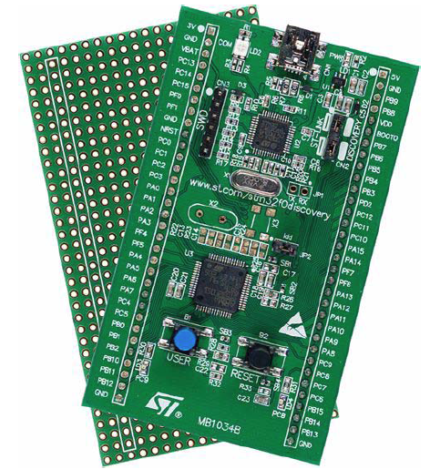
Development Tools/Equipment cont.
STM32F0-Discovery
STM32 F0-series microcontroller (48Mhz ARM 32-bit CortexTM-M0 CPU)
2 user LEDs, 1 user pushbutton
Extension header for quick connection to prototyping board

Slide 10
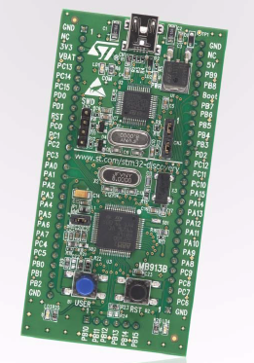
Development Tools/Equipment cont.
STM32VL-Discovery
STM32 F1-series microcontroller (24Mhz ARM 32-bit CortexTM-M3 CPU)
2 user LEDs, 1 user pushbutton
Extension header for quick connection to prototyping board

Slide 11
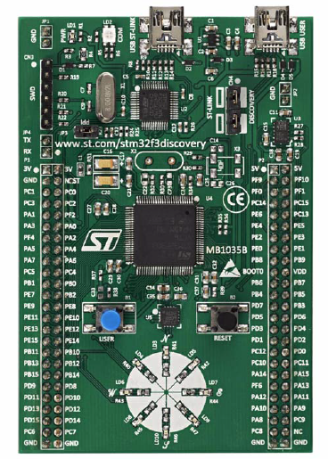
Development Tools/Equipment cont.
STM32F3-Discovery
STM32 F3-series microcontroller (72Mhz ARM 32-bit CortexTM-M4F CPU)
8 user LEDs, 1 user pushbutton
On-board Accelerometer, Compass and Gyroscope
Extension header for quick connection to prototyping board

Slide 12
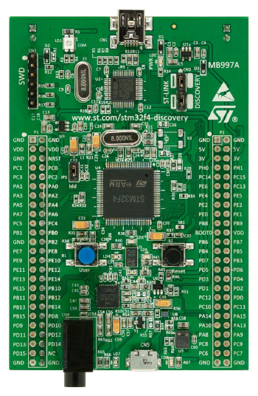
Development Tools/Equipment cont.
STM32F4-Discovery
STM32 F4-series microcontroller (168Mhz ARM 32-bit CortexTM-M4F CPU)
4 user LEDs, 1 user pushbutton
USB OTG, Accelerometer, Microphone, Audio Codec, 3.5mm Audio jack
Extension header for quick connection to prototyping board

Slide 13
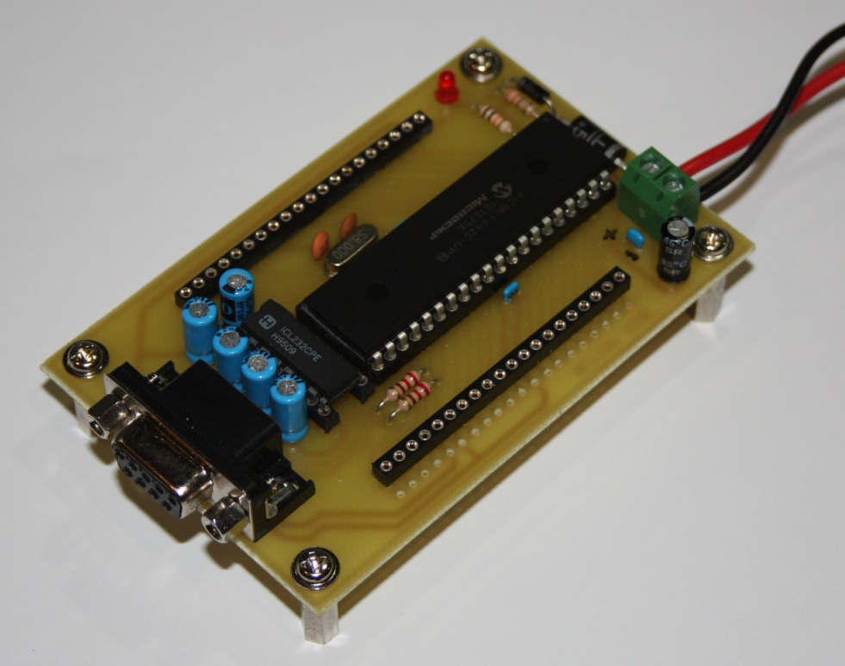
Development Tools/Equipment cont.
RS232 IO Controller
An easy-to-use, economical solution to allow a PC to interface with electronic circuits/devices using a standard RS232 port
Control software written in Visual Basic 2010
Outputs and inputs are not protected
8 outputs, 8 inputs, 8 inputs/outputs/alternate function
2 PWM outputs
5 Analog inputs
4 Servo motor outputs

Slide 14
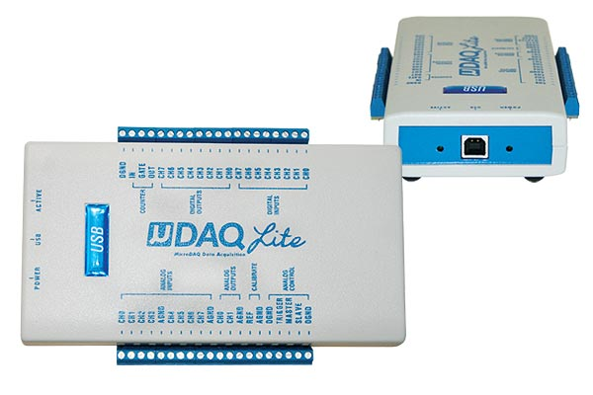
Development Tools/Equipment cont.
Eagle MicroDAQ-Lite
Professional solution to allow a PC to interface with electronic circuits/devices using a USB port
Control software written in Visual Basic 2010, C#, Delphi etc.
Outputs and inputs are protected
8 outputs, 8 inputs, 8 inputs/outputs/alternate function
2 D/A outputs
8 A/D inputs
1 Counter/Timer

Slide 15
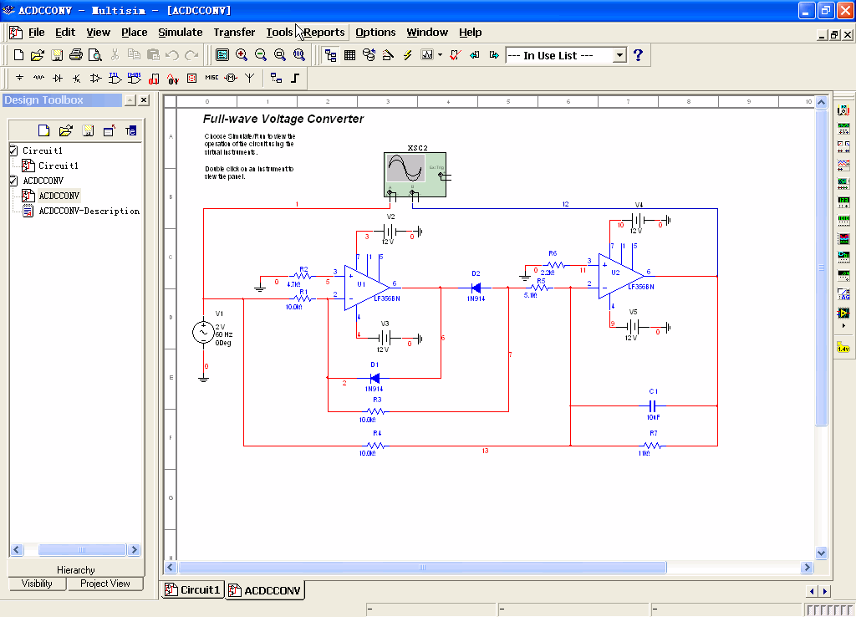
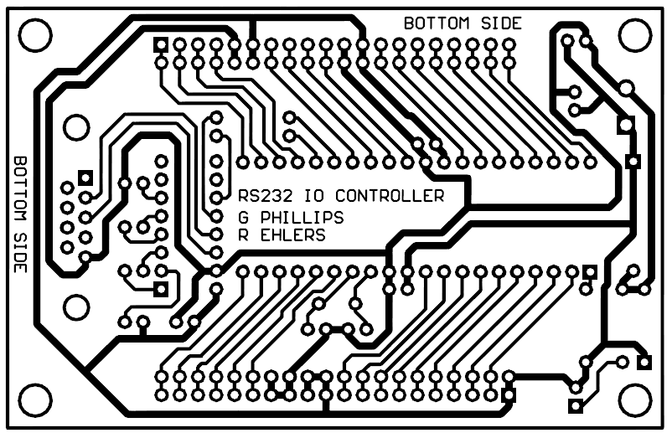
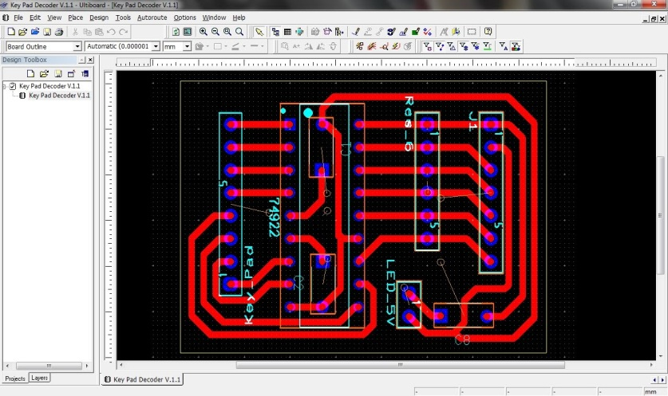
Development Tools/Equipment cont.
Schematic Design and Simulation software
NI MultiSim
PCB Design software
NI Ultiboard

Slide 16
Construction of the Project
Components
Start sourcing the components immediately after your Theoretical Design has been accepted
You can start doing research in pricing and availability of the more specialized components after the Draft Proposal has been accepted, but only order once the Theoretical Design is approved
Use components that are relatively easy to source; try and stay away from components not available in South Africa
Local suppliers are Rubicon, Cosmotronics, PnP Electronics
More specialized components will have to be sourced from other companies in Cape Town, Durban or Johannesburg (Logitech Electronics, Mantech, etc.)
Any Microchip devices can be received free of charge, depending on availability (see www.microchipdirect.com for exact part numbers)
– Also use http://za.rs-online.com/web/ for online orders (free delivery, but need Credit Card)

Slide 17
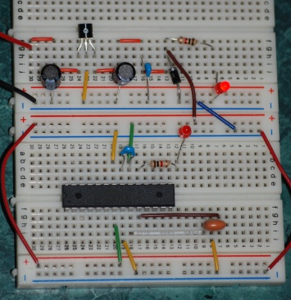
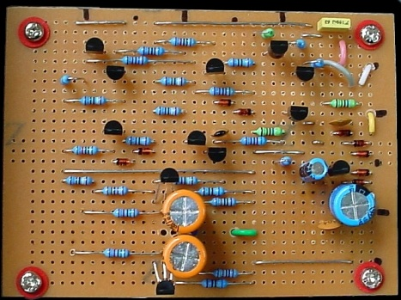
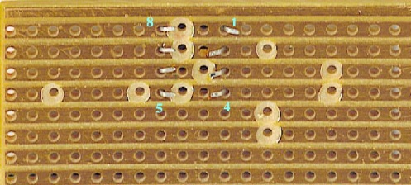
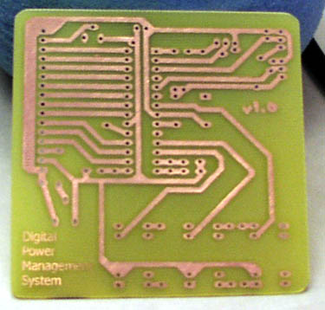
Construction of the Project cont.
Circuits
Circuits can be build on “breadboard”,
but not very professional
Vero board should rather be used,
but not suited for running a
Microcontroller directly from
(crystal impedance problems)
Custom made Printed Circuit Boards are the
best solution, but requires the use of PCB
Design software (Ultiboard). Single layer
PCBs can be manufactured locally
by Etching Foundry & Engravers
(± 60c/cm²)

Slide 18
Construction of the Project cont.
Models
Make use of hobby shops to find components to build the project prototype (e.g. balsa wood, rods, wheels, etc.)
Allow enough time for building the model
Place the project on a platform (wood or Perspex) and label the project (name, student number, project title) properly
Also make use of hobby shops to find servo motors, dc motors, stepper motors, and other sensors and actuators
Programming
Allow enough time (at least 2 – 3 weeks) for programming the control software
Use flowcharts and state machines to simply your design. Trust me, this will save you tons of hours in the long run.
Make sure you have the necessary access and licensing for the required programming software before you start the construction of the project

Slide 19
Project Evidence
Decide what are you going to present at the final evaluation
Fully functioning prototype (e.g. cocktail mixer; can demonstrate an actual cocktail being mixed)
Implement some of the actual hardware, but simulate others (e.g. Automatic lift; implement motor to raise/lower the lift, but use buttons and LEDs to simulate opening and closing of doors)
Simulating inputs and outputs will have an impact on the professionalism of the project, but is sometimes unavoidable. Make sure you discuss your decisions with the lecturer.
Make sure your intended evidence is clearly documented in the draft proposal
The lecturer will give you feedback and provide guidance on this after the draft proposal is marked
If you find that you cannot implement certain hardware at the final presentation, then discuss the possibility of simulating this hardware with the lecturer

Slide 20
Selecting a Project
Start finding a project immediately
Read electronic magazines
The Library has a large collection (Elektor, Practical Electronics, etc.)
Find online magazines
Speak to friends and family
Visit online hobby shops (e.g. www.hobbytronics.co.za)
They often have a collection of sensors and transducers that can trigger an idea with you (e.g. compass sensors, gps, etc.)
Can find links on there to other people’s project webpages
Youtube
Start watching videos of electronic projects, and as you start following the suggested videos, it can provide you with ideas of your own

Slide 21
Selecting a Project cont.
REMEMBER: You cannot use another person’s project
You have to make changes to the project OR
You have to prove that you saw the idea, but designed it from first principles without copying circuits or software from another project
Any copied work will be ignored and not marked and could lead to immediate failure of the subject
The original idea (online link or book reference) must form part of the draft proposal – if applicable

Slide 22
GOOD LUCK!
Remember to consult with the lecturer if you are unsure about certain aspects, this will ensure that you have a good chance at passing the subject

